Slide 1
Name of company
BUSINESS PLAN DATED DD MMM YYYY

Slide 2
Table of Content
Executive Summary
Financial Highlights
Vision and Mission
Business Overview - Milestones
Business Overview - Products and Services
Business Overview - Customers
Business Overview - Facilities
Organisation Chart
Profile of Management Team
Industry Overview
SWOT Analysis
Future Plans and Strategies
Management Action Plan
Financial Projections
Appendices

Slide 3
Executive Summary
[Business name] is a [description of the principal activities of the business] serving [description of customers].
Established in [year], the business started as a [description of the early days activities]. Over the years, the business has expanded to [description of current activities, size and/or capabilities].
[Business name] aims to be [describe the vision of the business].
To achieve the vision, [Business name] is planning to [briefly describe the business strategy or growth plan].

Slide 4
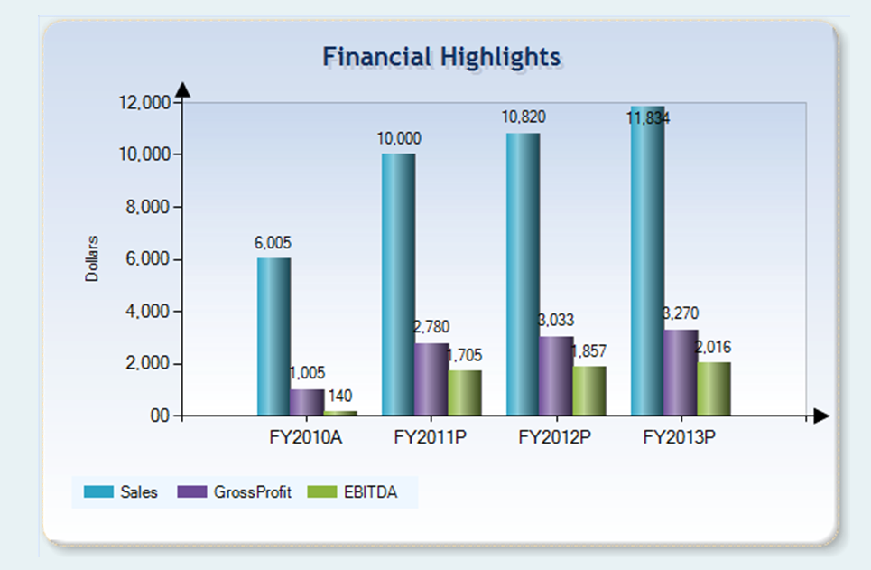
Financial Highlights
Sales is projected to [explanation of what drives the growth in sales].
Profit is projected to [explanation of reason for projected profits].

Slide 5


Vision & Mission
Vision
To define the business direction and the underlying core values and beliefs that guide employees and inspire them to do their best.
Mission
To define the business purpose and objectives for your team and shareholders.

Slide 6
Business Overview - Milestones
Year Major Milestones
Year 1
Year 2
Milestone 1
Milestone 2

Slide 7
Business Overview - Products & Services
Briefly describe the products and services by types. Include pictures, if available.

Slide 8
Business Overview - Customers
Briefly describe the customers, categorise them by the industry that they are in.

Slide 9
Business Overview - Facilities
Briefly describe the production lines, operating facilities and equipment if applicable

Slide 10
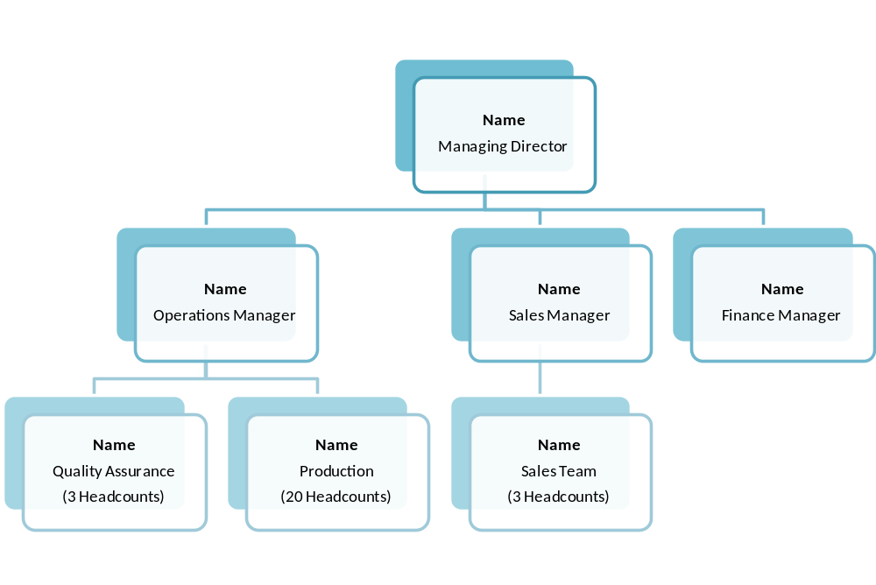
Organisation Chart
Sample for reference only
Total Headcount : xx

Slide 11
Profile of Management Team
Name 1, Managing Director
Indicate years of service, describe current roles and responsibilities, past experiences and qualifications.
Name 2, Position
Indicate years of service, describe current roles and responsibilities, past experiences and qualifications.
Name 2, Position
Indicate years of service, describe current roles and responsibilities, past experiences and qualifications.

Slide 12
Industry Overview
Describe the market size and provide statistics that you can obtain in relation to your business or industry
Describe any market trend
Describe any change in technology
Describe the challenges faced by your industry
Describe who your competitors are and what they are doing

Slide 13
SWOT Analysis
STRENGTHS
Describe the strengths of your business in competing for business (E.g., the 4 Ps, namely Place, Price, Products, Promotion; people and availability of other resources, including funding, etc)
WEAKNESSES
Describe the weaknesses of your business in competing for business (E.g., the 4 Ps, namely Place, Price, Products, Promotions; people and availability of other resources, including funding, etc)
OPPORTUNITIES
Describe the market opportunities that your business can take advantage of.
THREATS
Describe the potential threats that will weaken your position to compete in the market.

Slide 14
Future Plans and Strategies
Describe the new business or diversification (new activities, new geographical areas, etc) that you would like to pursue
Describe how you would like to expand your customer base
Describe how your would like to expand your product offerings
Describe what you will be doing to enhance your capabilities
Describe plans to create awareness of your brand
Describe plans to acquire or protect your intellectual properties

Slide 15
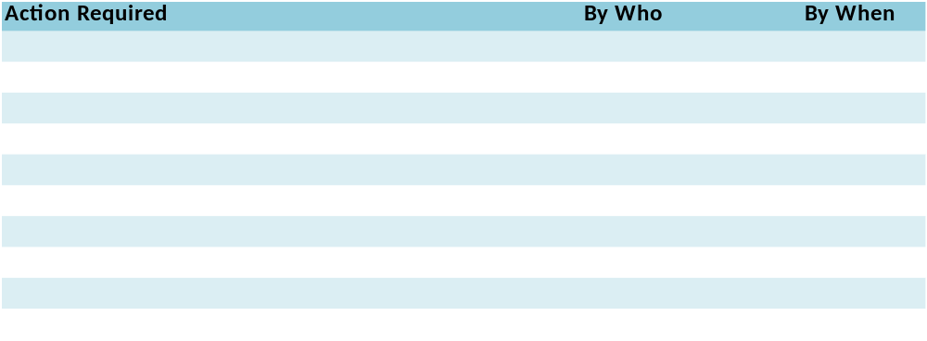
Management Action Plan
Describe the detailed action that Management plans to take to pursue its future plans– leveraging on strengths, improving on weaknesses, taking advantage of the opportunities and mitigating the impact of threats.
Example for reference
Plan to increase sales, reach out to new customers, etc
Plan to cut costs, specifying the types and quantifying your target if possible
Plan to invest in capital expenditure to build capabilities, expand capacity, etc

Slide 16
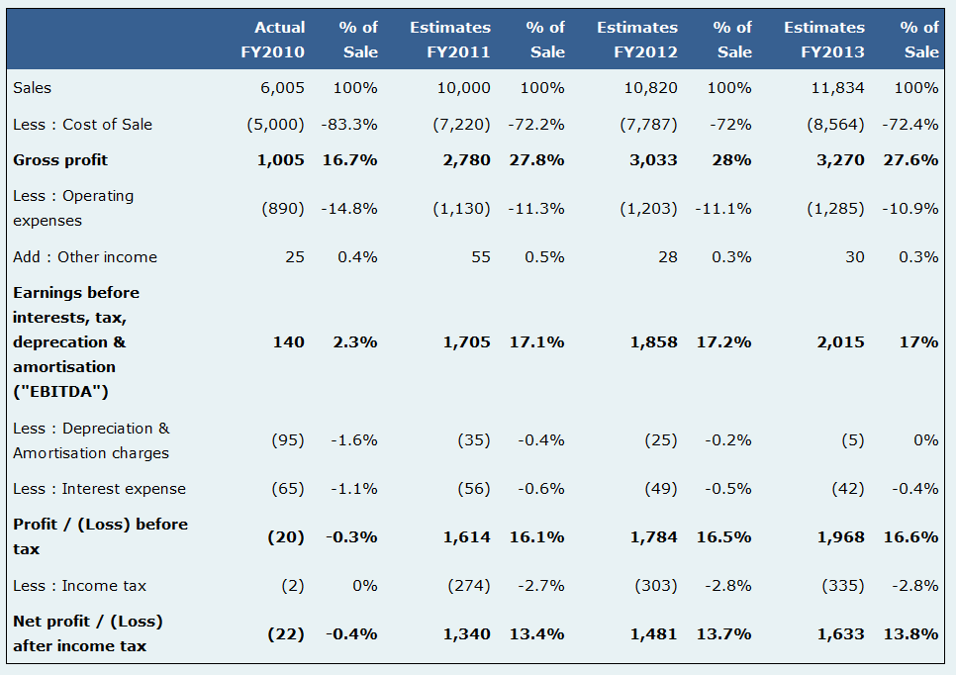
Financial Plan – Income Statement (sample)
This example is generated from the Financial Modeling Tool of the SME Financial Management Toolkit.

Slide 17
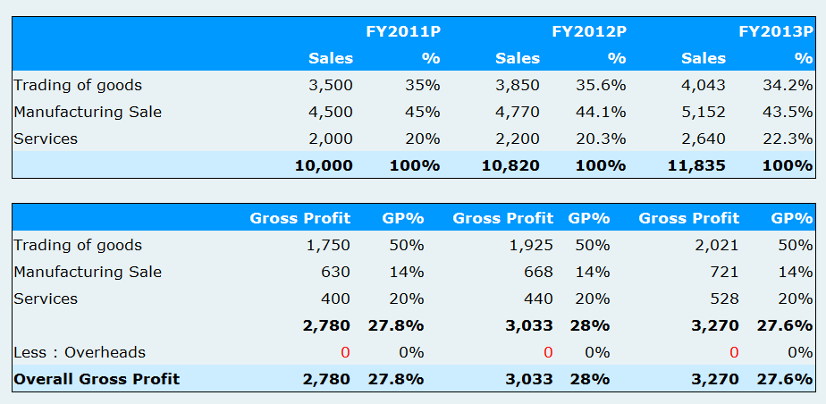
Financial Plan – Sales by Activities (sample)
This example is generated from the Financial Modeling Tool of the SME Financial Management Toolkit.

Slide 18
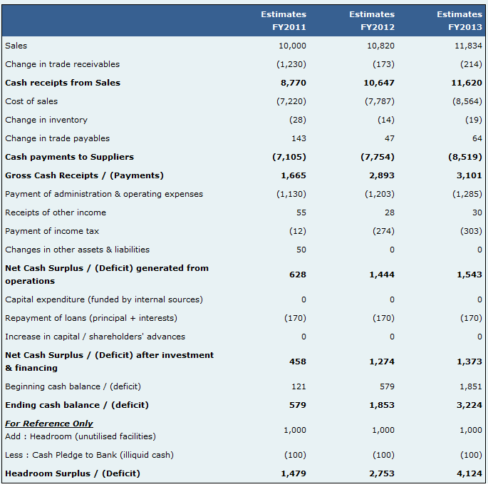
Financial Plan – Cash Flow (sample)
This example is generated from the Financial Modeling Tool of the SME Financial Management Toolkit.

Slide 19
APPENDICES

Slide 20
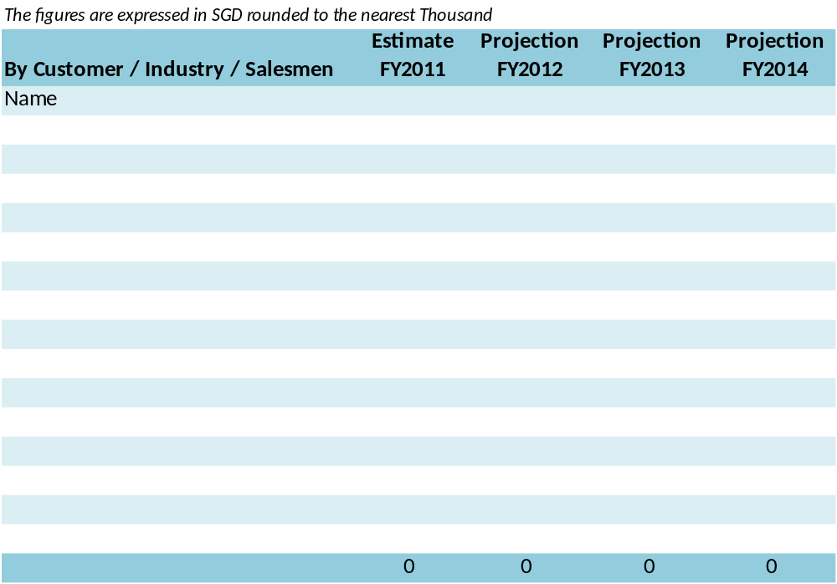
Financial Plan – Sales Target

Slide 21
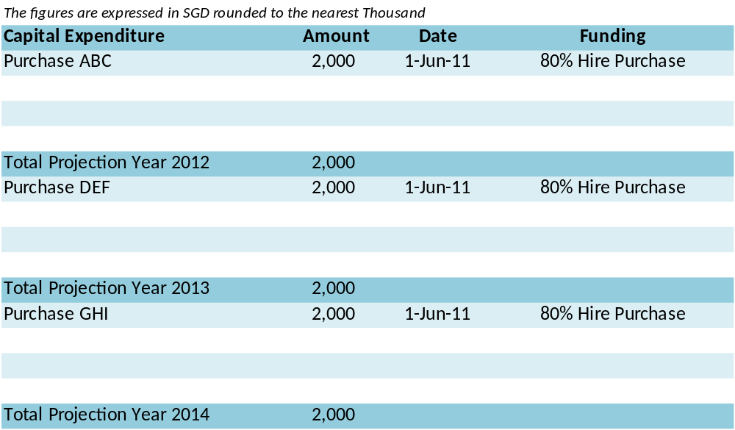
Financial Plan – Capital Expenditure

Slide 22
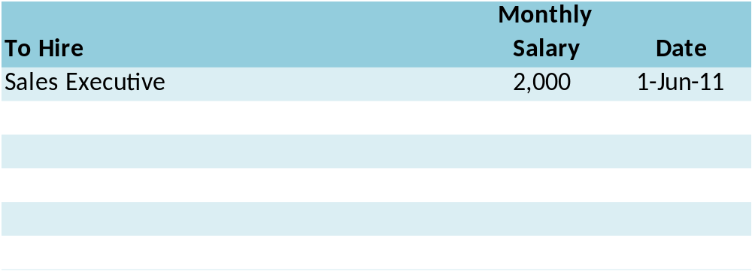
Financial Plan – Manpower Hiring Plan

